Slide 1
Complexity of Softwares

Slide 2
Agenda
Defining Software complexity
Four elements of complexity
The complexity of the problem domain
The difficulty of managing the development process
The flexibility possible through software
The problem of characterizing the behaviour of discrete system

Slide 3
Software
Personal or limited use
Industrial strength

Slide 4
Personal or Limited-Use Software
Software designed for individual use or restricted to a specific group or organization.
specific individual needs or small-scale applications, often with a limited set of behaviors and functionalities
Not very complex
Simple user interface - straightforward and intuitive user interface
A personal to-do list application
Narrow Scope - targets specific tasks or processes
A budget calculator application
Limited Data Handling - deals with small datasets or a restricted number of data fields
A personal address book application
Minimal Integration - not require extensive integration with other systems or external APIs
A simple offline photo editor with basic editing tools
Few Dependencies - minimal external dependencies or third-party libraries
A standalone unit converter
Quick Development Cycles - developed relatively quickly
A simple mobile game with basic gameplay mechanics

Slide 5
Industrial-strength software
Capability to handle complex and mission-critical tasks in large-scale environments
Rich Functionality - wide range of features and functionalities to address complex business processes and requirements
Enterprise Resource Planning (ERP) software
Performance and Scalability - efficiently process vast amounts of data and handle a large number of concurrent users
A cloud computing platform like Amazon Web Services (AWS)
Reliability and Availability - ensure uninterrupted operation even in challenging circumstances.
Database management systems like Oracle or Microsoft SQL Server
Complex Data Handling - manages complex data structures and relationships, often involving large databases and intricate data processing.
Customer Relationship Management (CRM) software
Security - robust measures to protect data and systems
Banking software with multi-layered security protocols
Resource-Optimization - work efficiently with scarce resources like computing power, memory, and network bandwidth
Flight control software in aviation
Regulatory Compliance - comply with industry-specific standards and legal requirements
Healthcare management systems
Long Development Cycles - undergoes extensive development, testing, and certification processes.
Spacecraft control software for space missions
Complexity exceeds human intellectual capacity

Slide 6
Inherent Complexity of Software (Elements)
the complexity of the problem domain
the difficulty of managing the development process
the flexibility possible through software
the problems of characterizing the behavior of discrete systems

Slide 7
Complexity of the problem domain
The "Complexity of Problem Domain" refers to the inherent intricacies and challenges present in the real-world scenario that the software intends to address.
Example 1: Consider the development of a weather prediction system.
The problem domain involves modeling complex atmospheric conditions, ocean currents, and climate patterns.
The interplay of these factors creates an inescapably complex problem domain, as the real-world climate system is intricate and challenging to comprehend fully.
Example 2: Let's examine the creation of a healthcare management system.
The problem domain requires a deep understanding of medical terminology, patient data privacy regulations, and healthcare workflows.
Accurate representation of these domain-specific complexities is essential to design a system that meets the needs of healthcare professionals and complies with legal requirements.

Slide 8
Complexity of the problem domain
Domain Knowledge:
the specialized understanding of the problem domain relevant to the software being developed.
It plays a vital role in ensuring that the software accurately addresses the unique challenges and requirements of the domain.
Example: Building an autonomous vehicle system requires domain knowledge in robotics, computer vision, and control systems to develop safe and efficient navigation algorithms.

Slide 9
Complexity of the problem domain
Functional Requirements:
What the software should do and the specific functionalities it must provide to meet user needs.
They are essential for the core operation of the software and directly impact its behavior.
Example: Developing an online shopping platform requires functional requirements such as product catalog, user registration, shopping cart, and secure payment processing.

Slide 10
Complexity of the problem domain
Non-Functional Requirements:
Specify how well the software should perform its functionalities and address aspects beyond functionality.
They include performance, security, usability, reliability, and other quality attributes.
Example: Creating a video conferencing application requires non-functional requirements like real-time video streaming, low latency, and robust data encryption for secure communication.

Slide 11
Complexity of the problem domain
Communication Gap:
The communication gap refers to the challenges that arise when users struggle to precisely express their needs, and developers may have difficulty understanding user requirements.
Example: Developing a customer relationship management (CRM) system for a sales team may face communication challenges, as the sales representatives may find it hard to articulate their exact needs and preferences

Slide 12
Complexity of the problem domain
Changing Environment:
The changing environment refers to the dynamic nature of software development, where requirements evolve due to user feedback, technological advancements, or regulatory changes.
Example: Designing an e-learning platform must adapt to changes in educational methodologies, new subjects, and evolving pedagogical trends.

Slide 13
Complexity of the problem domain
Large Capital Investment:
Software development often requires significant financial resources due to the complexity and scale of the projects.
This investment includes hiring skilled developers, maintaining servers, and conducting extensive testing and quality assurance.
Example: Developing a large-scale enterprise resource planning (ERP) system for a multinational corporation is a significant capital investment.

Slide 14
Mitigating Complexity
Collaborate with domain experts to gain a comprehensive understanding of the problem domain and ensure accurate representation in the software.
Use modular design and abstraction to break the complexity into manageable components.
Employ agile development methodologies to adapt to changing requirements effectively.
Establish effective communication channels between users and developers to bridge the communication gap.

Slide 15
The Difficulty of Managing the Development Process
Changing Requirements Software Requirements
Ex. a mobile banking app (account information and transaction history) → bill payment
Team Collaboration
Ex. web application project (frontend and backend developers)
Communication Challenges
Ex. an online shopping platform (design team and the development team )
Project Complexity
Ex. enterprise-level CRM -> integration with existing databases, third-party APIs, and multiple user interfaces
Notes:
Imagine you're tasked with building a software application that tracks inventory for a large retail company. The requirements seem straightforward at first: keep track of products, quantities, and manage restocking. However, as you delve deeper, you realize that the challenge lies in handling the evolving requirements, coordinating team efforts, and ensuring that the software works as intended.

Slide 16
The Flexibility Possible Through Software
Softwares can be modified, extended, and updated to cater to evolving requirements, user needs, and technological advancements
Complexity of Flexibility
Maintainability: ability to be maintained and improved over time
content management system with new feature to allow real-time collaboration among authors
Extensibility: accommodate future extensions
A food app with delivery tracking
Compatibility: compatible with evolving technologies, operating systems, and hardware
If browsers or mobile devices are updated for e-commerce website/app
Notes:
Imagine you're designing a weather forecasting application. You want it to not only provide accurate current conditions but also have the capability to incorporate new data sources, update algorithms, and adapt to changing weather patterns. This level of adaptability is unique to software and is a key factor contributing to its complexity.
Software, unlike physical systems, is remarkably flexible. It can be modified, extended, and updated to cater to evolving requirements, user needs, and technological advancements. However, this flexibility comes at a cost – the complexity of ensuring that these changes do not disrupt the existing functionality and introduce unintended consequences.

Slide 17
The Problem of Characterizing the Behavior of Discrete Systems
Discrete systems - Software systems as they process inputs, execute algorithms, and produce outputs step by step
Characterizing the behavior of a software system involves
understanding how it responds to different inputs and scenarios
predicting its performance
ensuring that it meets its intended requirements
Complexity of Prediction banking application -> number of users, transaction volumes, network latency, and more
Nonlinearity: small changes in inputs can lead to disproportionately different outcomes (like slide user load may slow down the system)
Emergent Behavior: a behavior that was not explicitly programmed (like video games with unexpected gameplay dynamics)
Interactions and Dependencies: Software components interact with each other and depend on various factors

Slide 18
Structure and Attributes of a Complex System

Slide 19
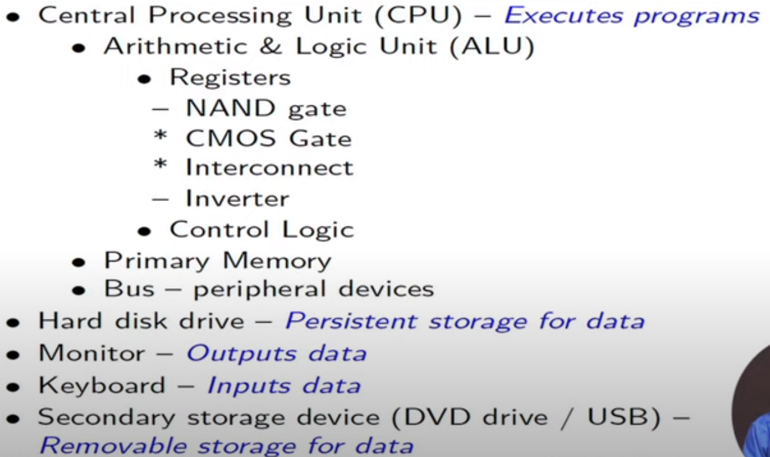
The structure of personal computer

Slide 20
Building Blocks (primitive elements)
Personal Computer
Gates - NAND, Inverter, etc.
Interconnections

Slide 21
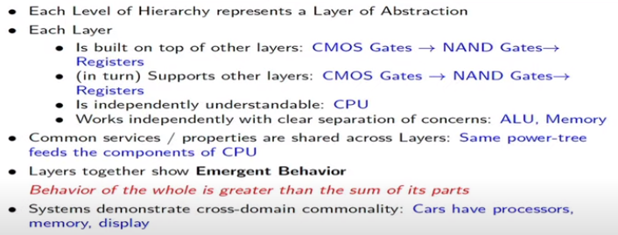
Complex System are Hierarchic

Slide 22
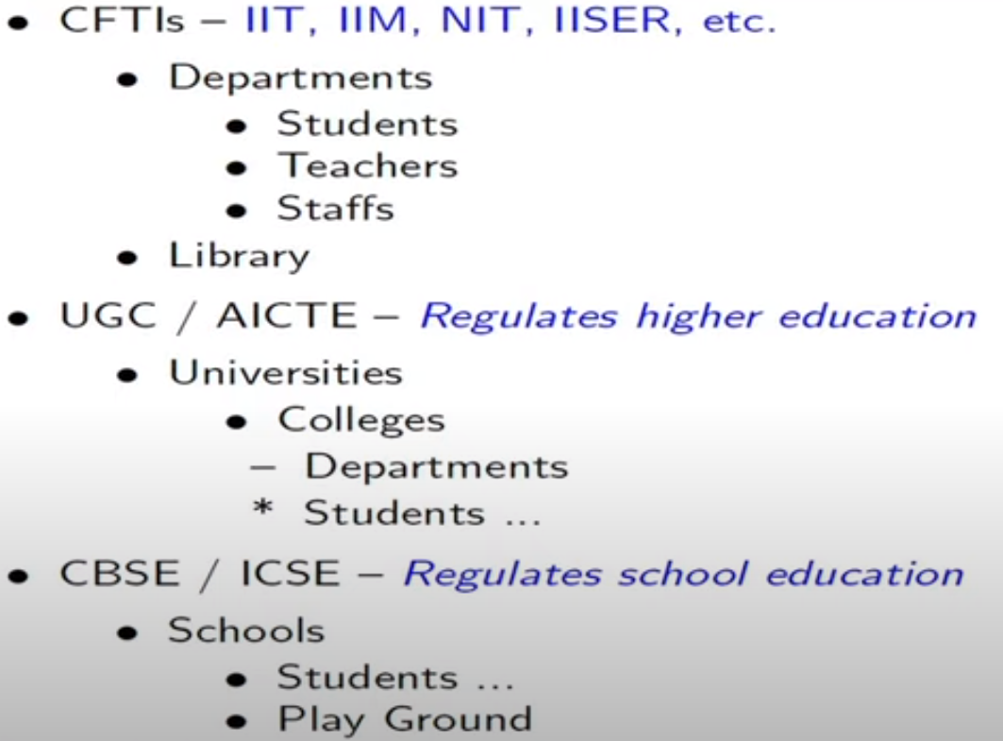
The structure of Education System in India

Slide 23
Building Blocks
Education system
Knowledge Delivery - Contact, Remote, MOOCs
Examination - Written, Oral, Practical
Admission
Graduation

Slide 24
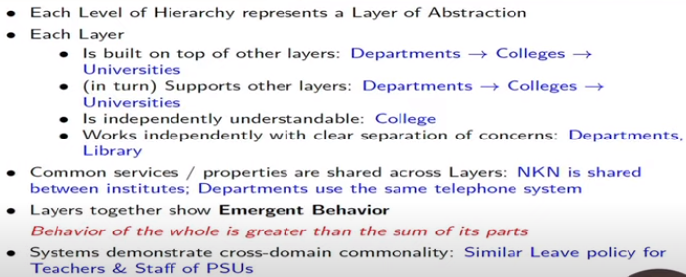
Complex System are Hierarchic

Slide 25
The Five Attributes of a Complex System
Hierarchic Structure
Relative Primitives
Separation of Concerns
Common Patterns
Stable Intermediate Forms

Slide 26
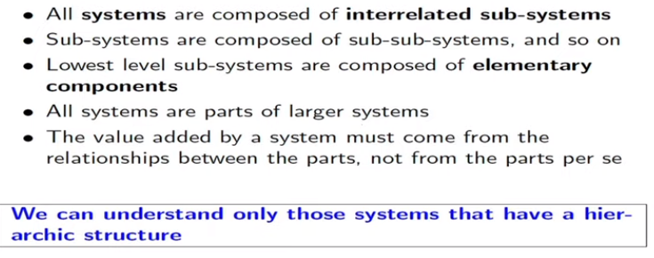
Hierarchic Structure

Slide 27
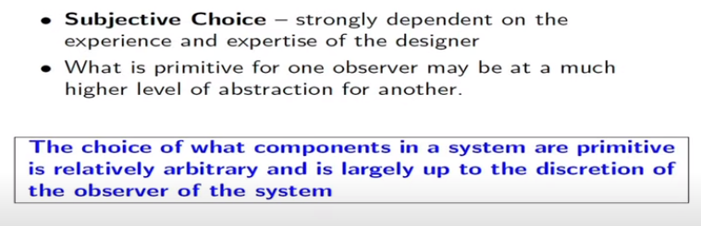
Relative Primitives

Slide 28
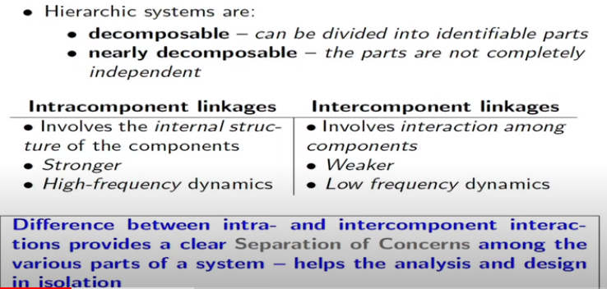
Separation of Concerns

Slide 29
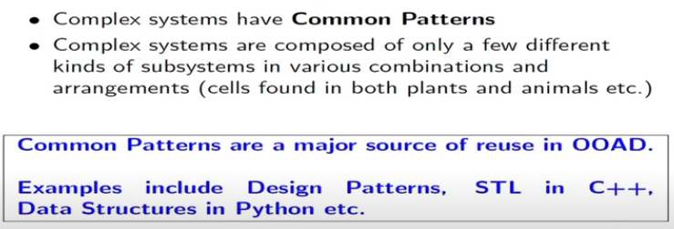
Common Patterns

Slide 30
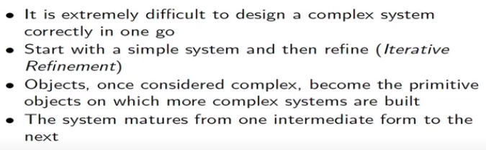
Stable Intermediate Forms
A complex system that works is invariably found to have evolved from a simple system that worked
A complex system designed from scratch never works and cannot be patched up to make it work

Slide 31
Object Oriented Analysis and Design

Slide 32
Handling complexity
Organized complexity
The Canonical Form of a Complex System
Disorganized Complexity
The limitations of the human capacity for dealing with complexity

Slide 33
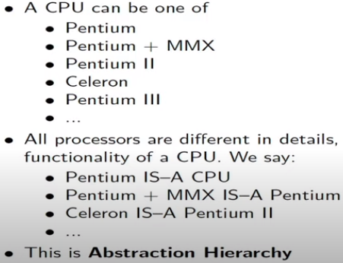
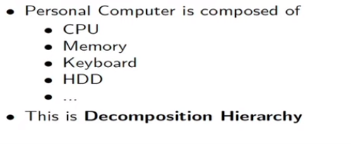
Hierarchies of Complex system
Decomposition - part-of or HAS-A
Abstraction - IS-A

Slide 34
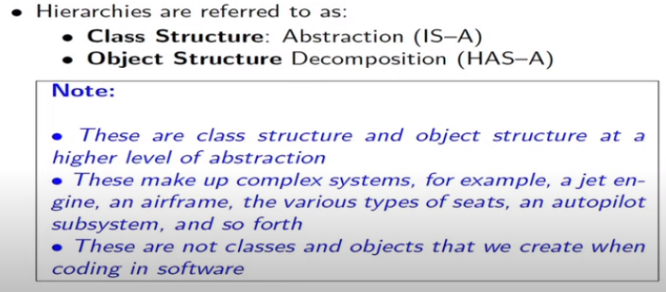
Class and Object Structures

Slide 35
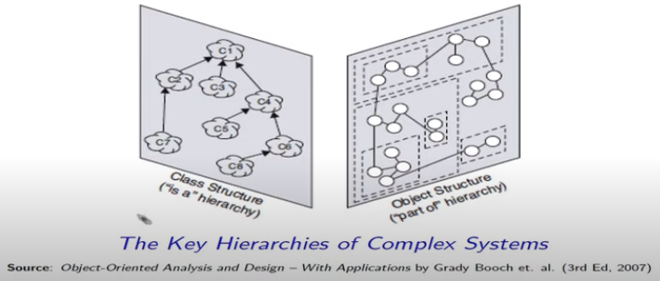
Key Hierarchies of Complex System

Slide 36
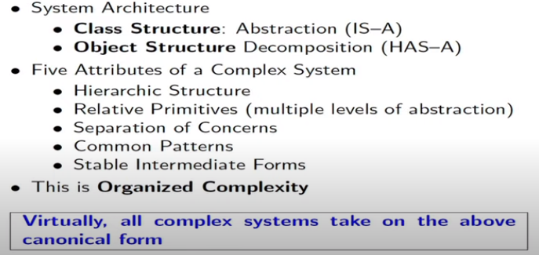
The canonical form of a complex system

Slide 37
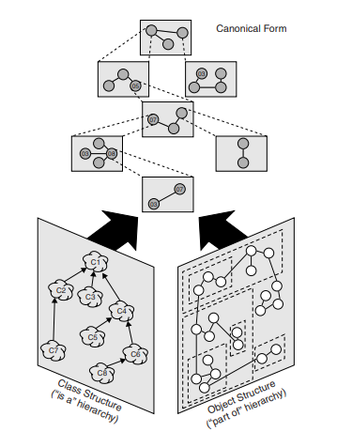
The canonical form of a complex system

Slide 38
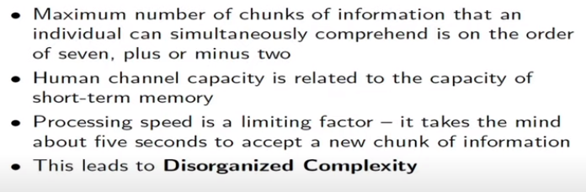
The Limitations of the Human Capacity for Dealing with Complexity

Slide 39
Bringing Order to Chaos

Slide 40
The Role of Decomposition
Algorithmic decomposition
Object-oriented decomposition
Algorithmic versus object-oriented decomposition

Slide 41
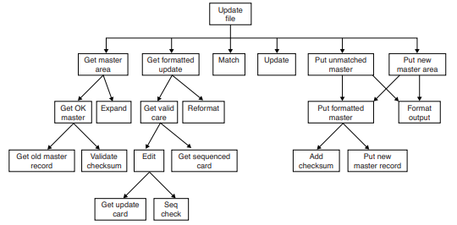
Algorithmic Decomposition
Top-down structured design
Divide and conquer
Decompose the problem into key processing steps

Slide 42
Algorithmic Decomposition
Design a program that updates the content of a master file
Automatically generated from a data flow diagram by an expert system tool
Decompose the problem into steps like get formatted updated and add checksum

Slide 43
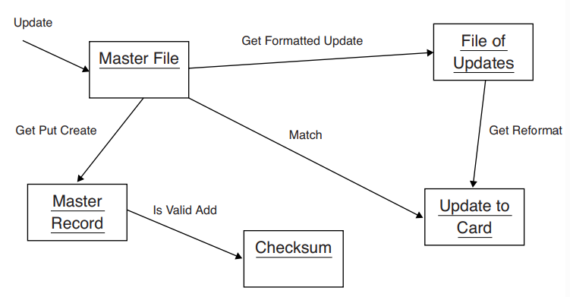
Object-oriented decomposition
Decompose the system according to the key abstractions in the problem domain.
we have identified objects such as Master File and Checksum, which derive directly from the vocabulary of the problem domain

Slide 44
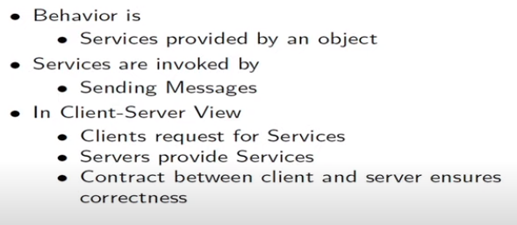
Client Server Computing Model

Slide 45
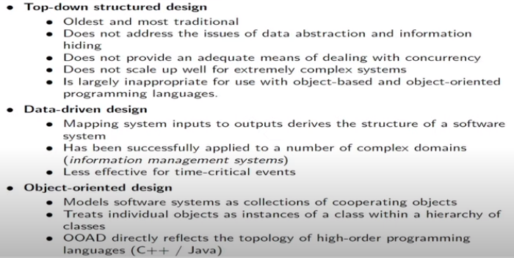
Algorithmic vs OO decomposition: Evolution of design methods

Slide 46
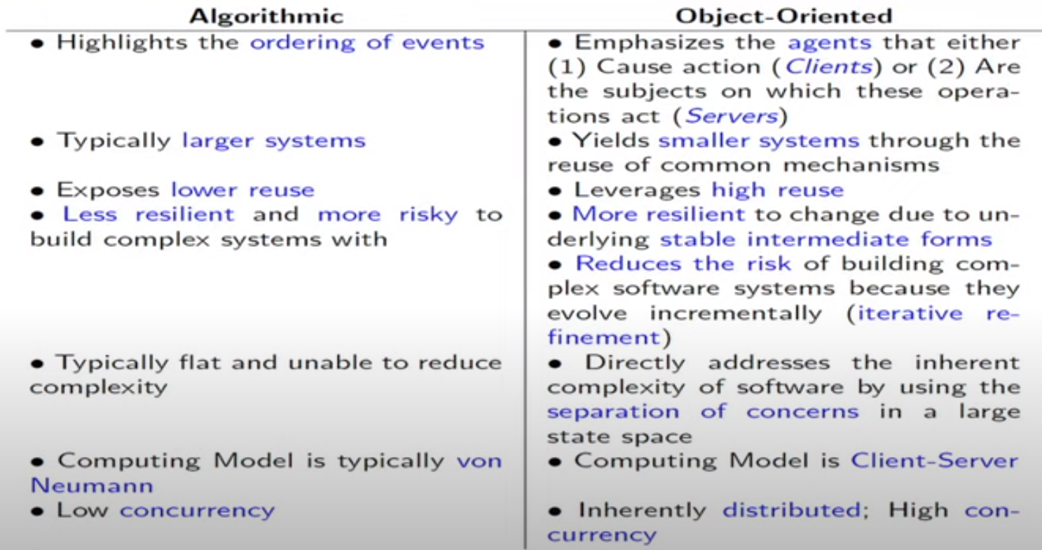
Algorithmic vs OO decomposition

Slide 47
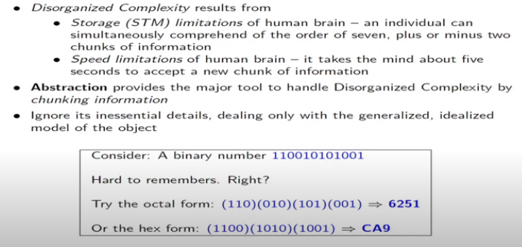
The role of abstraction

Slide 48
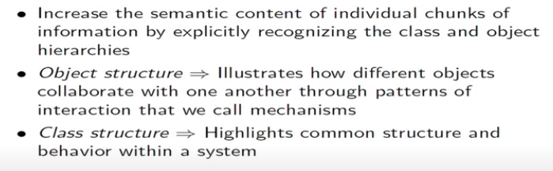
The role of Hierarchy

